Slide 1

Toyota Motor North America
TAGGING DECK FOR RCT

Slide 2
TAGGING DECK REFERENCE
Version | Description | Date
Initial version(v1) | Figma Link – KBB In-Page Experience – Figma | 26 September 2025
Important Instructions
1) The same tags documented in this tagging deck are applicable for the mobile site as well

Slide 3
Business requirements
Track KBB Trade In Page Views and Tool Engagement – Slide # 4
Track Step by Step Interactions and Engagement – Slide # 4-13
Step 1 - Usage of Make & Model and VIN – Slide # 4-7
Step 2 - Vehicle Condition, Options and Ownership Info – Slide # 8-10
Step 3 - Lead Gate - Vehicle of Interest, Contact Info and Lead Submission – Slide #11-12
Step 4 - Trade In Information display, Inventory and other tools – Slide #13
Completion Rate – Key metrics used as - km-​trade-shown , km-​trade-start , km-​trade-complete
Track 90 day close rates

Slide 4
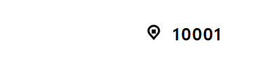
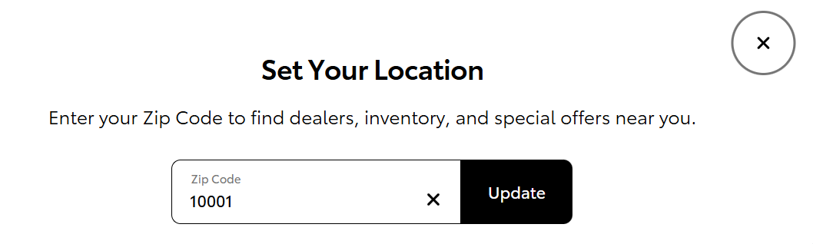
Local special homepage - Zip Code
1
Tag(s) to fire (Metrics)
1.a) aa-pageload,km-offers-search,km-qualified-action,km-engaged-traffic
1.b) aa-content-view
1.c) aa-component-view
2.a ) aa-link
2.b) aa-content-view
3.a) aa-link
4) aa-dialog-close
Tag(s) to Fire (Metrics) | Values to Track
All server calls listed in this slide should contain the following:
Global Block, Link Block
1.a) Link Block
Please see the context variables, values, and blocks above
2.a) Link Block
link_type_title = “zip code” link_text = “zip”
2.b) Link Block
Content_section = “your location overlay”
3. Link Block
link_type_title = “update” link_text = “update”, Content_section = “your location overlay”
4. Link Block
link_type_title = “dialog close” link_text = “dialog close”, link_trigger = “aa-link”, Content_section_linkName = “tcom:greaterny:deals-incentives:home:modal:dialog close”
2
4
3
Notes:
4

Slide 5
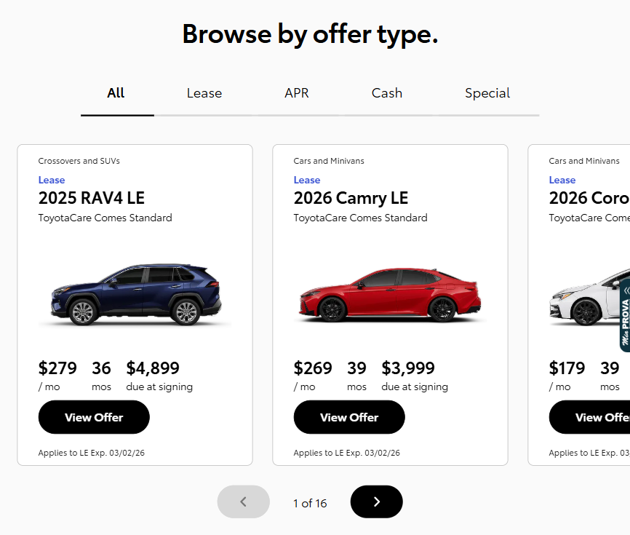
Local special homepage - Browser by offer type
Tag(s) to fire (Metrics)
1.a) aa-content-view
1.b) aa-component-view
2.a) aa-link
2.b) aa-content-view
3) aa-link
Tag(s) to Fire (Metrics) | Values to Track
All server calls listed in this slide should contain the following:
Global Block , Link Block
1.a) Link Block
content_section = “browse by offer type”
1.b) Link Block
content_section = “browse by offer type”
2.a). Link Block
content_section = “browse by offer type” link_type_title = “tabs” link_text = “all, lease, apr, cash, special” link_action = “aa-link”
2.b) Link Block
content_section = “browse by offer type” content_subsection = “all, lease, apr, cash, special” link_type_title = “tabs” link_text = “all, lease, apr, cash, special” link_action = “aa-link”
3) Link Block
content_section = “browse by offer type” content_subsection = “all, lease, apr, cash, special” link_type_title = “offer card” link_text = “view offer” link_action = “aa-link”
1
2
3
5
4
Notes:
5

Slide 6
Local special homepage - Browser by offer type
Tag(s) to fire (Metrics)
4) aa-link
5 ) aa-link
Tag(s) to Fire (Metrics) | Values to Track
4 ) Link Block
content_section = “browse by offer type” content_subsection = “all, lease, apr, cash, special” link_type_title = “toggles” link_text = “right arrow” link_action = “aa-link”
5 ) Link Block
content_section = “browse by offer type” content_subsection = “all, lease, apr, cash, special” link_type_title = “toggles” link_text = “left arrow” link_action = “aa-link”
5
4

Slide 7
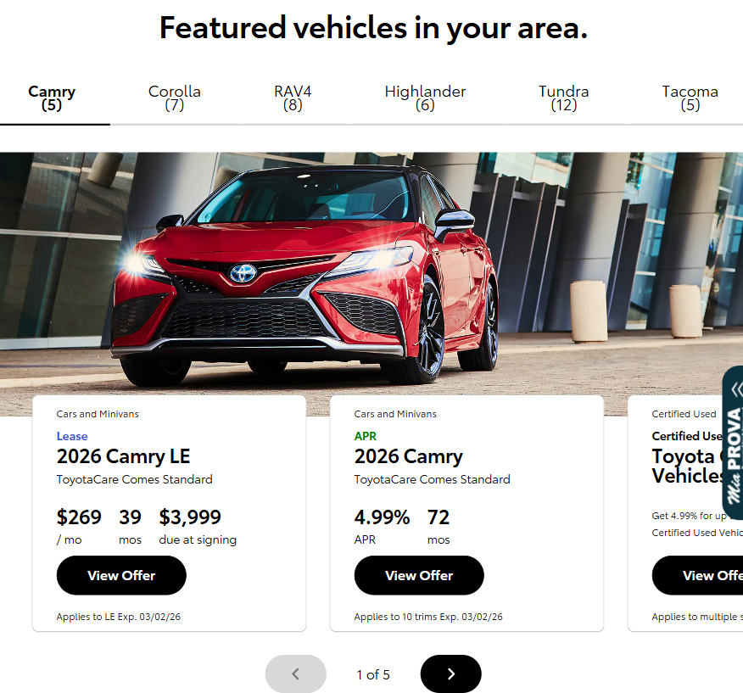
Local special homepage - Featured vehicles in your area
2
1
Tag(s) to fire (Metrics)
1.a) aa-content-view
1.b) aa-component-view
2.a) aa-link
2.b) aa-content-view
3) aa-link
Tag(s) to Fire (Metrics) | Values to Track
All server calls listed in this slide should contain the following:
Global Block , Link Block
1.a) Link Block
content_section = “featured vehicle offers”
1.b) Link Block
content_section = “featured vehicle offers”
2.a). Link Block
content_section = “featured vehicle offers” link_type_title = “tabs” link_text = “camry, corolla, rav4, highlander, tundra, tacoma” link_action = “aa-link”
2.b) Link Block
content_section = “featured vehicle offers” content_subsection = “camry, corolla, rav4, highlander, tundra, tacoma” link_type_title = “tabs” link_text = “camry, corolla, rav4, highlander, tundra, tacoma” link_action = “aa-link”
3) Link Block
content_section = “featured vehicle offers” content_subsection = “camry, corolla, rav4, highlander, tundra, tacoma” link_type_title = “offer card” link_text = “view offer” link_action = “aa-link”
3
5
4
Notes:
7

Slide 8
Local special homepage - Featured vehicles in your area
2
1
Tag(s) to fire (Metrics)
4) aa-link
5 ) aa-link
Tag(s) to Fire (Metrics) | Values to Track
4 ) Link Block
content_section = “featured vehicle offers” content_subsection = “camry, corolla, rav4, highlander, tundra, tacoma” link_type_title = “toggles” link_text = “right arrow” link_action = “aa-link”
5 ) Link Block
content_section = “featured vehicle offers” content_subsection = “camry, corolla, rav4, highlander, tundra, tacoma” link_type_title = “toggles” link_text = “left arrow” link_action = “aa-link”
3
5
4

Slide 9
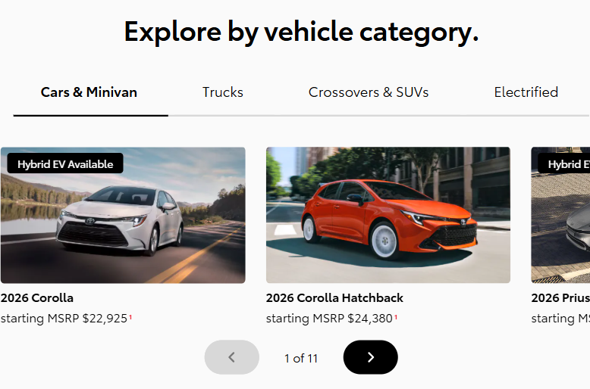
Local special homepage - Explore by vehicle category
1
Tag(s) to fire (Metrics)
1.a) aa-content-view
1.b) aa-component-view
2.a) aa-link,km-engaged-traffic
2.b) aa-content-view
Tag(s) to Fire (Metrics) | Values to Track
All server calls listed in this slide should contain the following:
Global Block , Link Block
1.a) Link Block
content_section = “explore offers by vehicle”
1.b) Link Block
content_section = “explore offers by vehicle”
2.a). Link Block
content_section = “explore offers by vehicle” content_subsection = “cars-minivan, trucks, crossovers-suvs, electrified” link_type_title = “tabs” link_text = “cars-minivan, trucks, crossovers-suvs, electrified” link_action = “aa-link”
2.b) Link Block
content_section = “explore offers by vehicle” content_subsection = “cars-minivan, trucks, crossovers-suvs, electrified” link_type_title = “tabs” link_text = “cars-minivan, trucks, crossovers-suvs, electrified” link_action = “aa-link”
2
4
3
Notes:
9

Slide 10
Local special homepage - Explore by vehicle category
1
Tag(s) to fire (Metrics)
3) aa-link
4) aa-link
Tag(s) to Fire (Metrics) | Values to Track
3 ) Link Block
content_section = “explore offers by vehicle” content_subsection = “cars-minivan, trucks, crossovers-suvs, electrified” link_type_title = “toggles” link_text = “right arrow” link_action = “aa-link”
4 ) Link Block
content_section = “explore offers by vehicle” content_subsection = “cars-minivan, trucks, crossovers-suvs, electrified” link_type_title = “toggles” link_text = “left arrow” link_action = “aa-link”
2
4
3

Slide 11
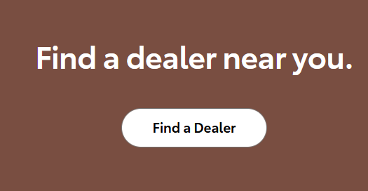
Local special homepage –Find a dealer
Tag(s) to fire (Metrics)
1) aa-component-view
2.a) aa-link
2.b) aa-link
2.c) aa-component-view
2.d) aa-component-view
Tag(s) to Fire (Metrics) | Values to Track
All server calls listed in this slide should contain the following:
Global Block , Link Block
1) Link Block
content_section = “find a dealer near me”
2.a) Link Block
content_section = “find a dealer near me” link_text = “find a dealer” link_action = “aa-link”
2.b) Link Block
link_text = “link” link_text_title= “find a dealer” link_action = “aa-link”
2.c) Link Block
content_section = “find dealer search result board”
2.d) Link Block
content_section = “find dealer search result board”
1
2
Notes:
11

Slide 12
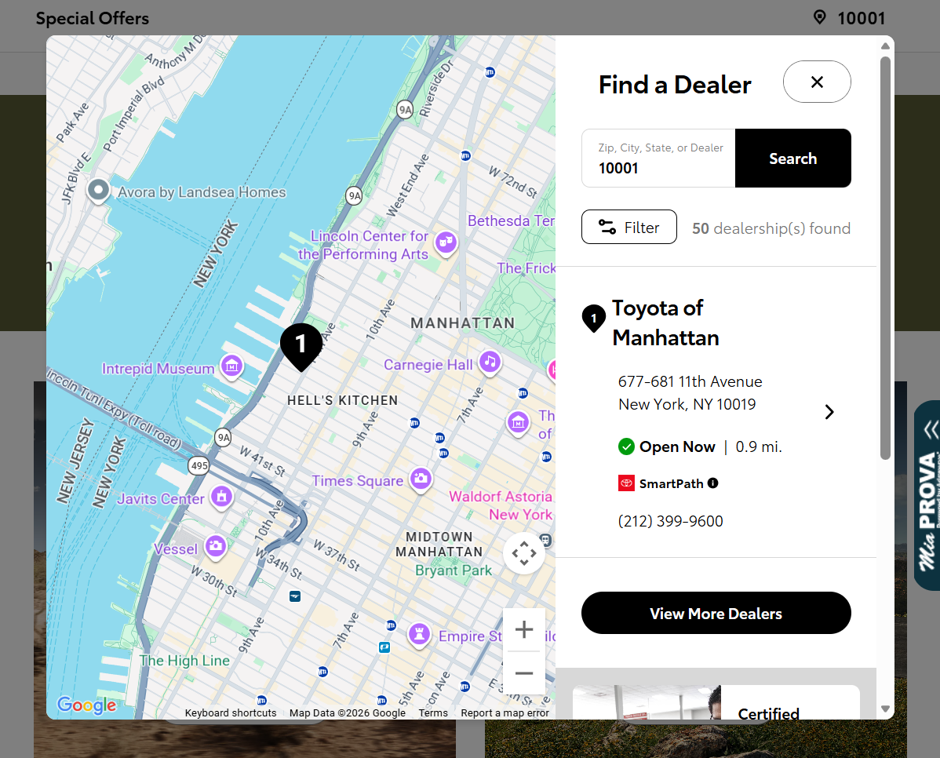
Local special homepage –Find a dealer
5
Tag(s) to fire (Metrics)
1) aa-pageload,km-dealer-search,km-qualified-action
2) aa-link
3) aa-pageload,km-dealer-search,km-qualified-action
4) aa-link
5) aa-dialog-close
Tag(s) to Fire (Metrics) | Values to Track
All server calls listed in this slide should contain the following:
Global Block , Link Block
1) Link Block
content_section = “find dealer search result board”
2) Link Block
content_section = “find dealer search result board” link_text = “search” Link-trigger = “aa-link”
3) Link Block
content_section = “find dealer search result board”
4) Link Block
content_section = “find dealer search result board”
5) Link Block
link_type_title = “dialog close” link_text = “dialog close”, link_trigger = “aa-action”,
1
2
3
4
Notes:
12

Slide 13
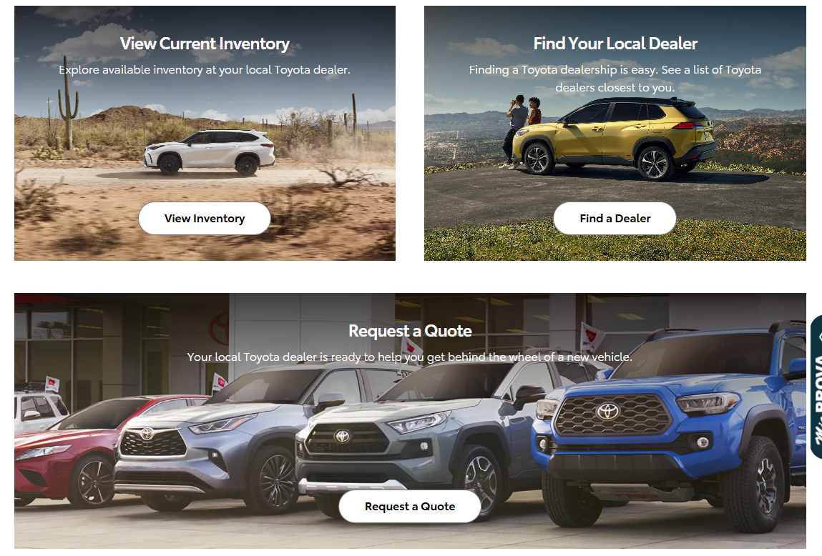
Local special homepage – View inventory
Tag(s) to fire (Metrics)
1) aa-link
Tag(s) to Fire (Metrics) | Values to Track
All server calls listed in this slide should contain the following:
Global Block , Link Block
1) Link Block
link_text = “view inventory” link_text_title= “view current inventory” link_action = “aa-link” Content-section = “cta blocks”
1
Notes:
13

Slide 14
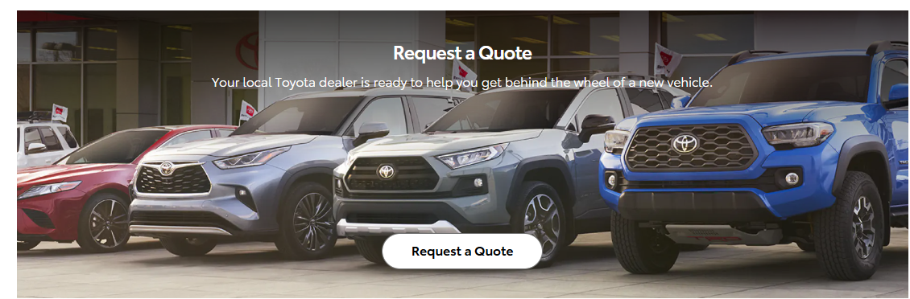
Local special homepage – Request a Quote
Tag(s) to fire (Metrics)
1) aa-link
2) aa-link
Tag(s) to Fire (Metrics) | Values to Track
All server calls listed in this slide should contain the following:
Global Block , Link Block
1) Link Block
link_action= “aa-link” Content-section = “raq form overlay”
2) Link Block
link_text = “request a quote” link_text_title= “request a quote” Content-section = “cta blocks”
1
Notes:
14

Slide 15
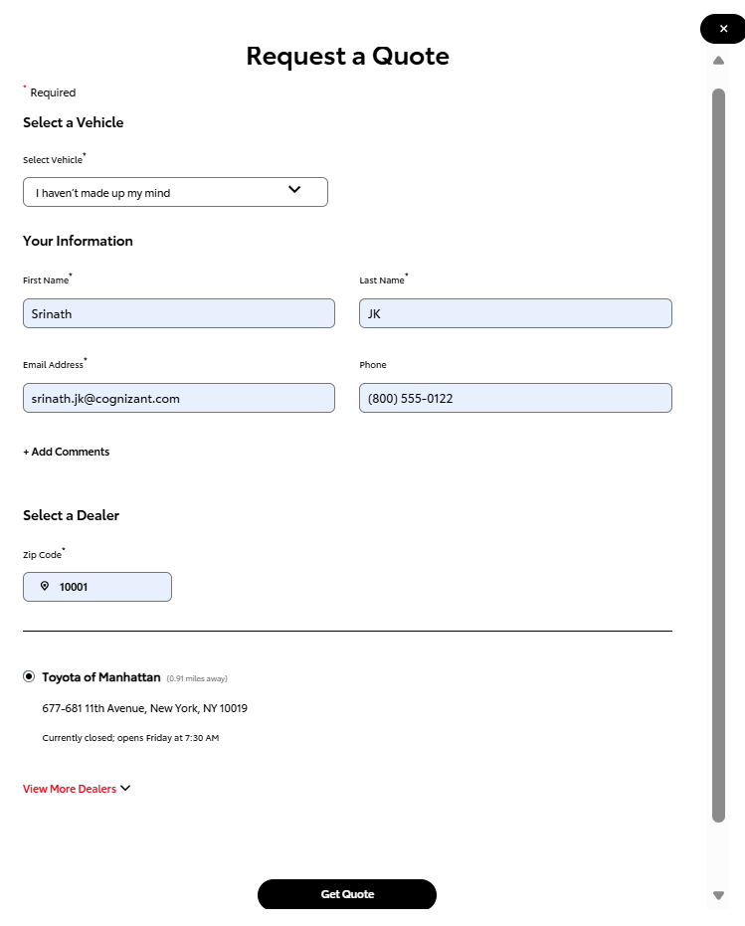
Local special homepage – Request a Quote
1
6
Tag(s) to fire (Metrics)
1) aa-pageload,km-raq-shown
2) aa-action,km-raq-start,km-lead-start,km-qualified-action
3) aa-link
4) aa-link
5) aa-action,km-raq-complete,km-lead-complete,km-raq-complete-once_30days,km-raq-complete-once_visit,km-raq-complete-once_page,km-raq-complete-once_visitor,km-lead-complete-once_30days,km-lead-complete-once_visit,km-lead-complete-once_page,km-lead-complete-once_visitor
6) aa-link
Tag(s) to Fire (Metrics) | Values to Track
All server calls listed in this slide should contain the following:
Global Block, Link Block
1) Link Block
content_section = “raq form overlay”
2) Link Block
content_section = “raq form overlay” link_text = “vehicle” link_action = “aa-link”
3) Link Block
content_section = “raq form overlay” link_text = “zipcode” link_action = “aa-link”
4) Link block
link_text = “view more dealers” link_action = “aa-link”
5) Link Block
link_text = “get quote” link_action = “aa-link”
6) Link Block
content_section = “raq form overlay” link_text = “close model” link_action = “aa-link”
2
3
4
5
Notes:
15

Slide 16
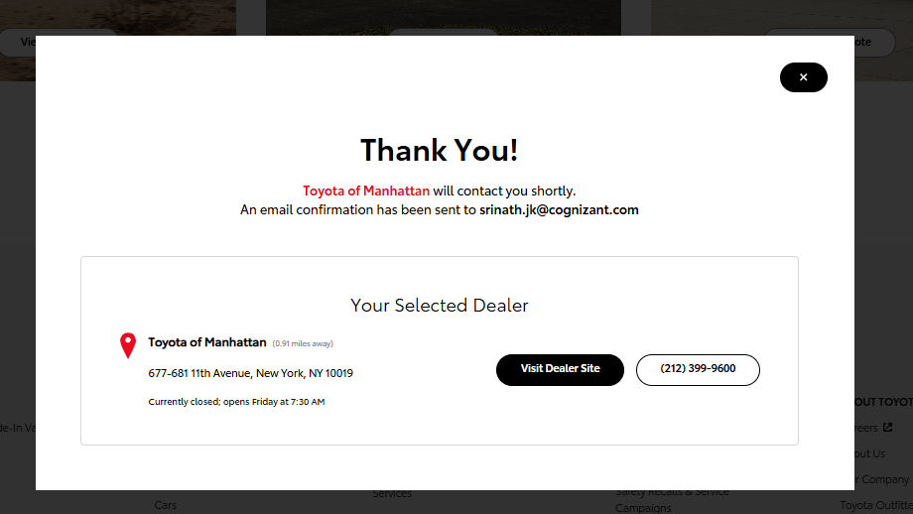
Local special homepage – Request a Quote
Tag(s) to fire (Metrics)
1) aa-link,km-dealer-visit_site,km-engaged-traffic
2) aa-link
Tag(s) to Fire (Metrics) | Values to Track
All server calls listed in this slide should contain the following:
Global Block, Link Block
1) Link Block
content_section = “raq form overlay” link_text = “visit dealer site” link_action = “km-link”
2) Link Block
content_section = “raq form overlay” link_text = “close model” link_action = “aa-link”
2
1
Notes:
16

Slide 17
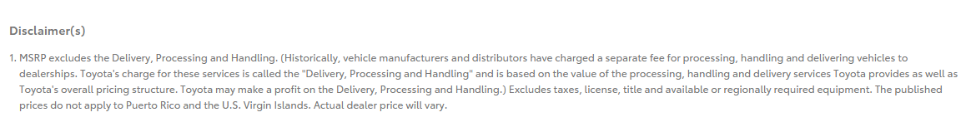
Local special homepage – Disclaimer
Tag(s) to fire (Metrics)
1) aa-component-view
Tag(s) to Fire (Metrics) | Values to Track
All server calls listed in this slide should contain the following:
Global Block , Link Block
1) Link Block
content_section = “disclaimer module”
1
Notes:
17

Slide 18
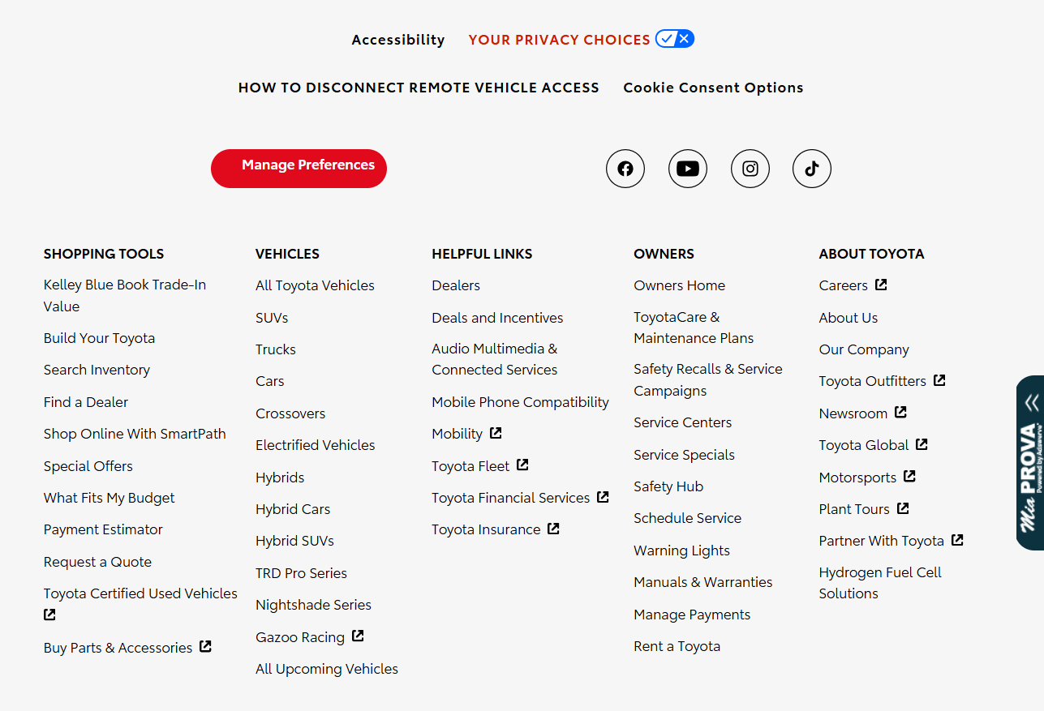
Local special homepage – Global nav Footer
Tag(s) to fire (Metrics)
1)aa-link
2)aa-link
3) aa-link
4) aa-link,km-owners-clickout
Tag(s) to Fire (Metrics) | Values to Track
All server calls listed in this slide should contain the following:
Global Block , Link Block
1) Link Block
content_section = “global nav footer”
2) Link Block
content_section = “global nav footer” link_text = “your privacy choices” link_trigger = “aa-link” Link_type_title = “your privacy choices”
3) Link Block
content_section = “global nav footer” link_text = “how to disconnect remote vehicle access” link_trigger = “aa-link” Link_type_title = “how to disconnect remote vehicle access” Link_type = “link”
4) Link block
content_section = “global nav footer” link_text = “manage preferences” link_trigger = “aa-link” Link_type_title = “manage preferences” Link_type = “link”
1
2
3
4
5
Notes:
18

Slide 19
Local special homepage – Global nav Footer – Cookies consent
Tag(s) to fire (Metrics)
5.a) aa-link
5.b) aa-component-view
6 ) aa-link,km-social-clickout
7) aa-link
Tag(s) to Fire (Metrics) | Values to Track
5.a) Link Block
content_section = “global nav footer” link_text = “cookie consent options” link_trigger = “aa-link” Link_type_title = “cookie consent options”
5.b) Link Block
content_section = “cookie consent options module”
6) Link Block
content_section = “global nav footer” link_text = “facebook, youtube, Instagram, tiktok” Link_type_title = “facebook, youtube, Instagram, tiktok” link_count = “1,2,3,4”
7_ Link Block
content_section = “global nav footer” link_text = “shopping tools, vehicles, helpful links, owners, about toyota” Link_type_title = “shopping tools, vehicles, helpful links, owners, about toyota” Link_type = “button”
5
7
6

Slide 20
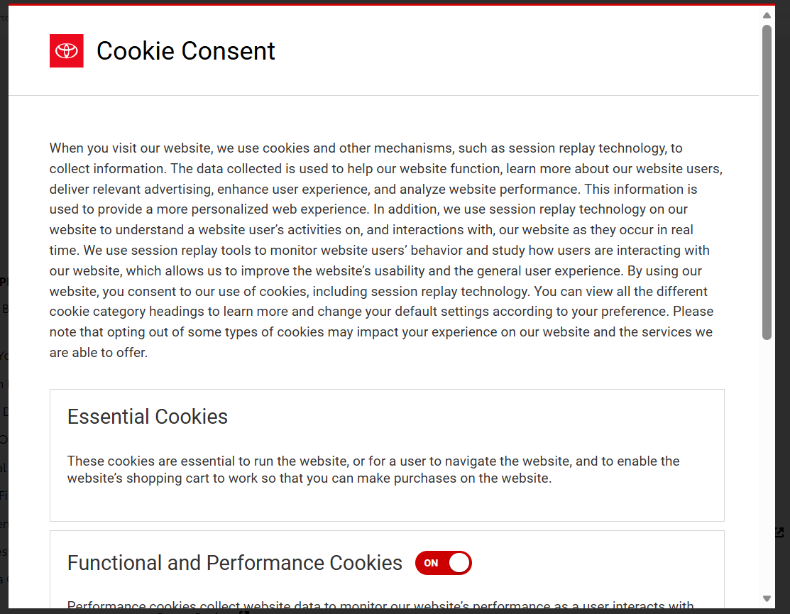
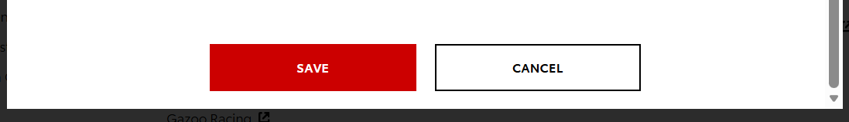
Local special homepage – Global nav Footer - > cookies click
Tag(s) to fire (Metrics)
1) aa-link,km-engaged-traffic
2) aa-link
Tag(s) to Fire (Metrics) | Values to Track
All server calls listed in this slide should contain the following:
Global Block , Link Block
1) Link Block
content_section = “cookie consent options module” link_text = “save” Link_type_title = “cookie consent”
2) Link Block
content_section = “cookie consent options module” link_text = “cancel” Link_type_title = “cookie consent”
1
2
Notes:
20

Slide 21
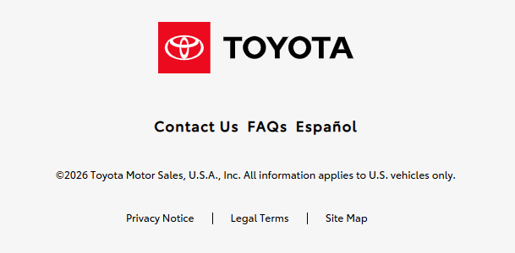
Local special homepage – Global nav Footer
Tag(s) to fire (Metrics)
1)aa-link
2)aa-link
3) aa-link
Tag(s) to Fire (Metrics) | Values to Track
All server calls listed in this slide should contain the following:
Global Block , Link Block
1) Link Block
content_section = “global nav footer” link_text = “contact us” link_trigger = “aa-link” Link_type_title = “contact us” Link_type = “link” content_subsection = “global footer”
2) Link Block
content_section = “global nav footer” link_text = “faqs” link_trigger = “aa-link” Link_type_title = “faqs” Link_type = “link” content_subsection = “global footer”
3) Link Block
content_section = “global nav footer” link_text = “español” link_trigger = “aa-link” Link_type_title = “español” Link_type = “link” content_subsection = “global footer”
2
1
3
Notes:
21

Slide 22
Local special homepage – Global nav Footer
Tag(s) to fire (Metrics)
1.a) aa-component-view
1.b)aa-link
2.a) aa-component-view
2.b)aa-link
3.a) aa-component-view
3.b)aa-link
Tag(s) to Fire (Metrics) | Values to Track
All server calls listed in this slide should contain the following:
Global Block , Link Block
1.a) Link Block
content_section = “global nav footer”
1.b) Link Block
content_section = “global nav footer” link_text = “privacy notice” link_trigger = “aa-link” Link_type_title = “privacy notice” Link_type = “link”
2.a) Link Block
content_section = “global nav footer”
2.b) Link Block
content_section = “global nav footer” link_text = “legal terms” link_trigger = “aa-link” Link_type_title = “legal terms” Link_type = “link”
3.a) Link Block
content_section = “global nav footer”
3.b) Link Block
content_section = “global nav footer” link_text = “site map” link_trigger = “aa-link” Link_type_title = “site map” Link_type = “link”
1
3
2
Notes:
22

Slide 23
OFFER Page
Notes:
23

Slide 24
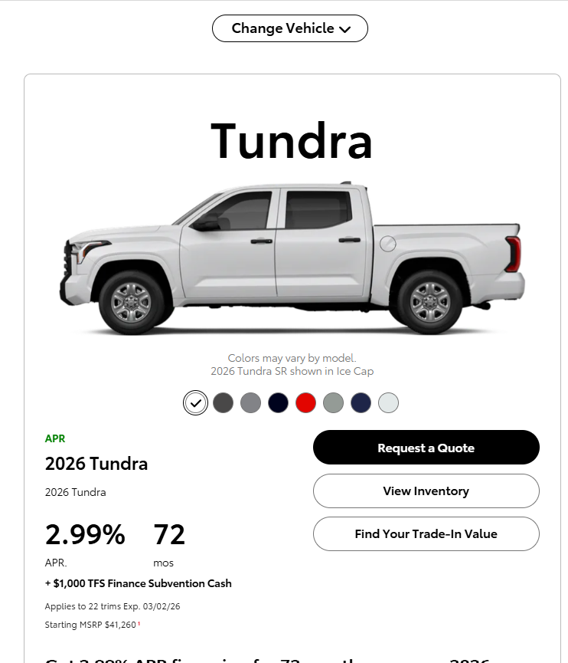



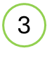
OFFER OVERVIEW
Tag(s) to fire (Metrics)
1 a. aa-link,
1 b. aa-pageload,km-raq-shown
2. aa-link
3. aa-link
Tag(s) to Fire (Metrics) | Values to Track
All server calls listed in this slide should contain the following:
Global Block , Page Block, Offer Block, User Block
app_name = “rct” content_section = “offer overview” content_subsection = “offer next step”
1. Link Block
link_text = “request a note” link_trigger = “aa-link”
2. Link Block
link_text = “view inventory”, link_trigger = “aa-link”
3. Link Block
link_text = “find your trade-in value” link_trigger = “aa-link”
Notes:
24

Slide 25
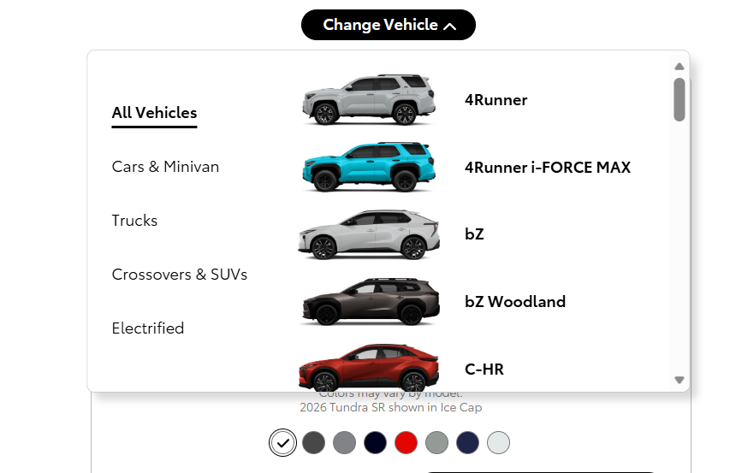
OFFERS FILTER
1
Tag(s) to fire (Metrics)
1 a. aa-link
1 b. aa-component-view
Tag(s) to Fire (Metrics) | Values to Track
All server calls listed in this slide should contain the following:
Global Block , Page Block , User Block
app_name = “rct” content_section = “offers filter” content_subsection = “vehicles”
1 a. Link Block
link_text = “change vehicle” link_trigger = “aa-link”

Slide 26
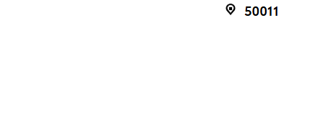

OFFERS FILTER
Tag(s) to fire (Metrics)
1 a. aa-link
1 b. aa-content-view
Tag(s) to Fire (Metrics) | Values to Track
All server calls listed in this slide should contain the following:
Global Block , Page Block, User Block
app_name = “rct”
1 a. content_section=“offers filter” content_subsection=“zip”
1 a. Link Block
link_text = “zip” link_trigger = “aa-link”
1
1 b.content_section=“your location overlay”

Slide 27
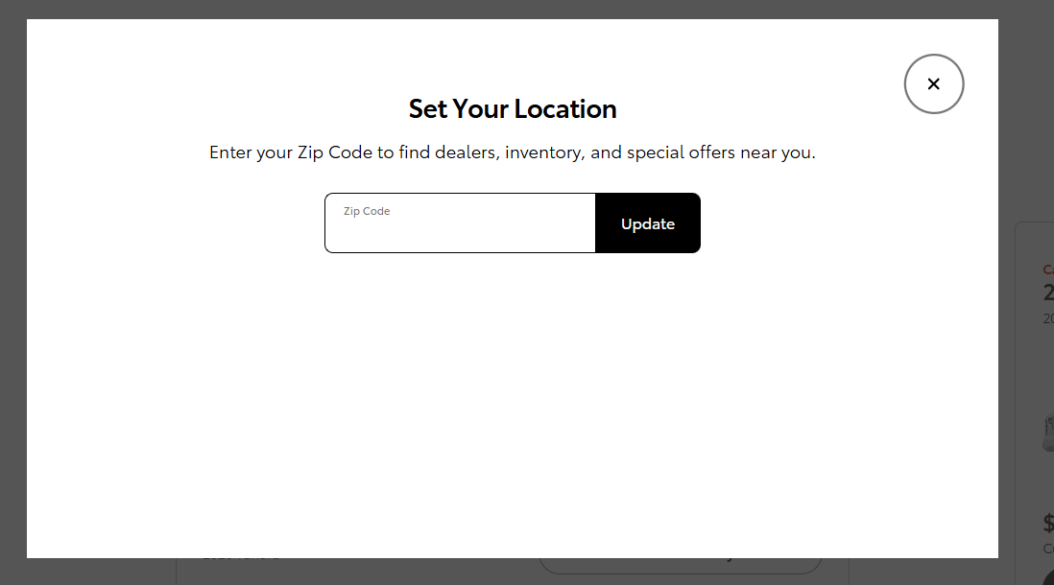
YOUR LOCATION OVERVIEW
Tag(s) to fire (Metrics)
1 a. aa-link
1 b. aa-dialog-close
Tag(s) to Fire (Metrics) | Values to Track
All server calls listed in this slide should contain the following:
Global Block , Page Block , User Block
app_name = “rct”
1 a.content_section=“your location overlay”
1 a.Link Block
link_text = “update” link_trigger = “aa-link”
1

Slide 28
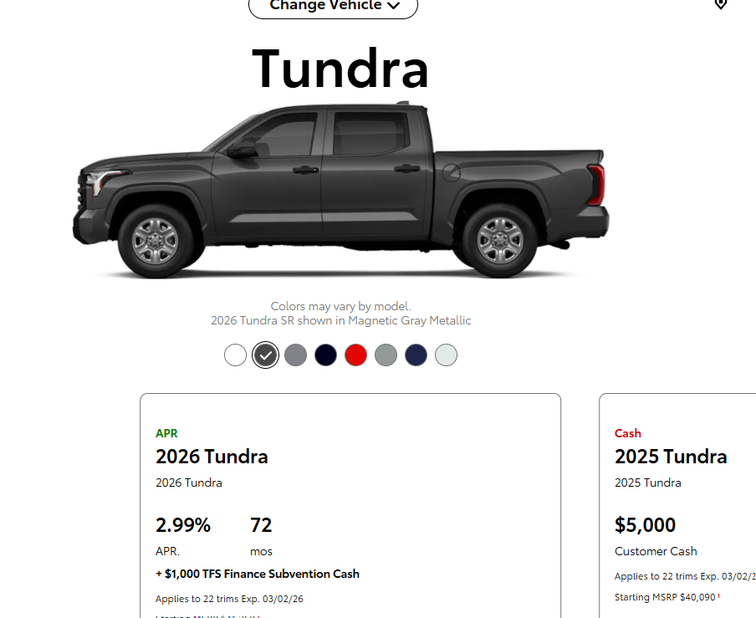
OFFER OVERVIEW
Tag(s) to fire (Metrics)
1 a. aa-link,km-engaged-traffic
1 b. aa-link
Tag(s) to Fire (Metrics) | Values to Track
All server calls listed in this slide should contain the following:
Global Block , Page Block ,Offer Block,User Block
app_name = “rct”
1 a. content_section=“offer overview” content_subsection=“colorizer”
1 a. Link Block
link_text = “2026 prius le shown in cutting edge”
1 b. Link Block
Link_trigger=“aa-link” Link_text=“2026 prius le shown in cutting edge”
1

Slide 29
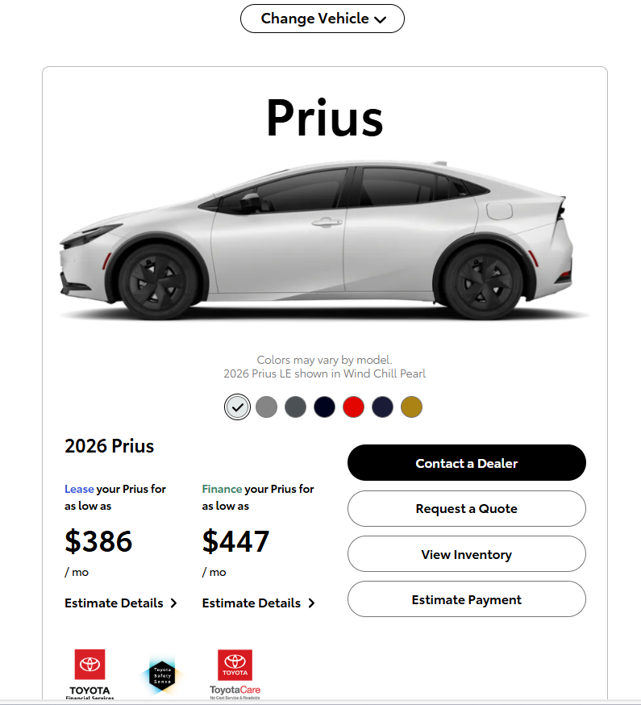

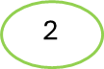
OFFER OVERVIEW
Tag(s) to fire (Metrics)
1 a. aa-link,
1 b. aa-pageload,km-cad-shown
2. aa-link
Tag(s) to Fire (Metrics) | Values to Track
All server calls listed in this slide should contain the following:
Global Block , Page Block, Offer Block , User Block
app_name = “rct”
1 a.content_section = “offer overview” content_subsection = “offer next step”
1 a. Link Block
link_text = “contact a dealer” link_trigger = “aa-link”
1 b.content_section=“cad form overlay” content_subsection=“offers next step”
2.content_section=“offer overview” content_subsection=“offer next step”
2. Link Block
link_text = “estimate payment”, link_trigger = “aa-link”

Slide 30
OFFER OVERVIEW
Tag(s) to fire (Metrics)
1 a. aa-link
All server calls listed in this slide should contain the following:
Global Block , Page Block, Offer Block , User Block
app_name = “rct” content_section = “offer overview”
1 a. Link Block
link_text = “estimate details” link_trigger = “aa-link”
1

Slide 31
OFFER OVERVIEW
Tag(s) to fire (Metrics)
1 a. aa-link
1 b. aa-link
All server calls listed in this slide should contain the following:
Global Block , Page Block ,Offer Block,User Block
app_name = “rct”
1 a. content_section=“offer overview” content_subsection=“colorizer”
1 a. Link Block
link_text = “2026 prius le shown in guardian gray”
1 b. Link Block
Link_trigger=“aa-link” Link_text=“2026 prius le shown in cutting edge”

Slide 32
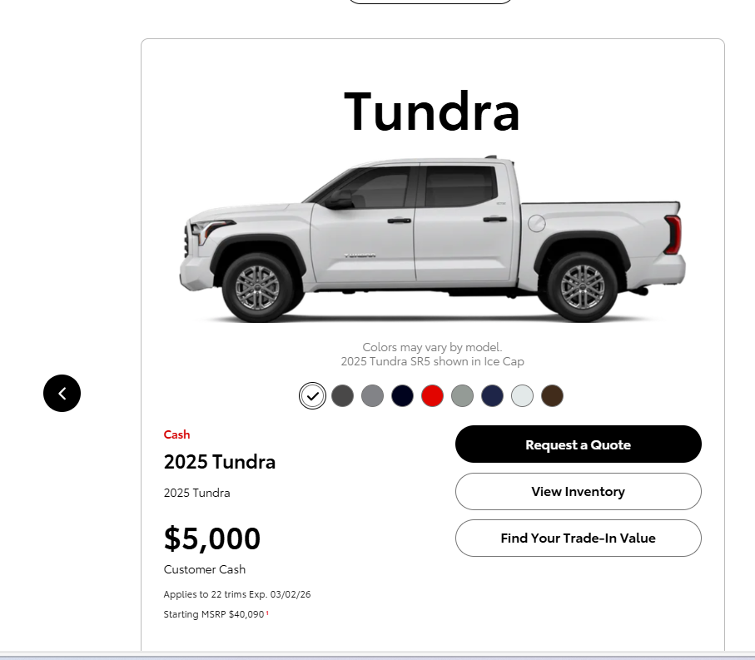

OFFER OVERVIEW
Tag(s) to fire (Metrics)
1 a. aa-link
1 b. aa-pageload,km-offers-detail,km-qualified-action
All server calls listed in this slide should contain the following:
Global Block , Page Block ,Offer Block,User Block
app_name = “rct” content_section=“offer overview”
1 a. content_subsection=“offer next step”
1 a. Link Block
link_text = “next arrow”

